Slide 1
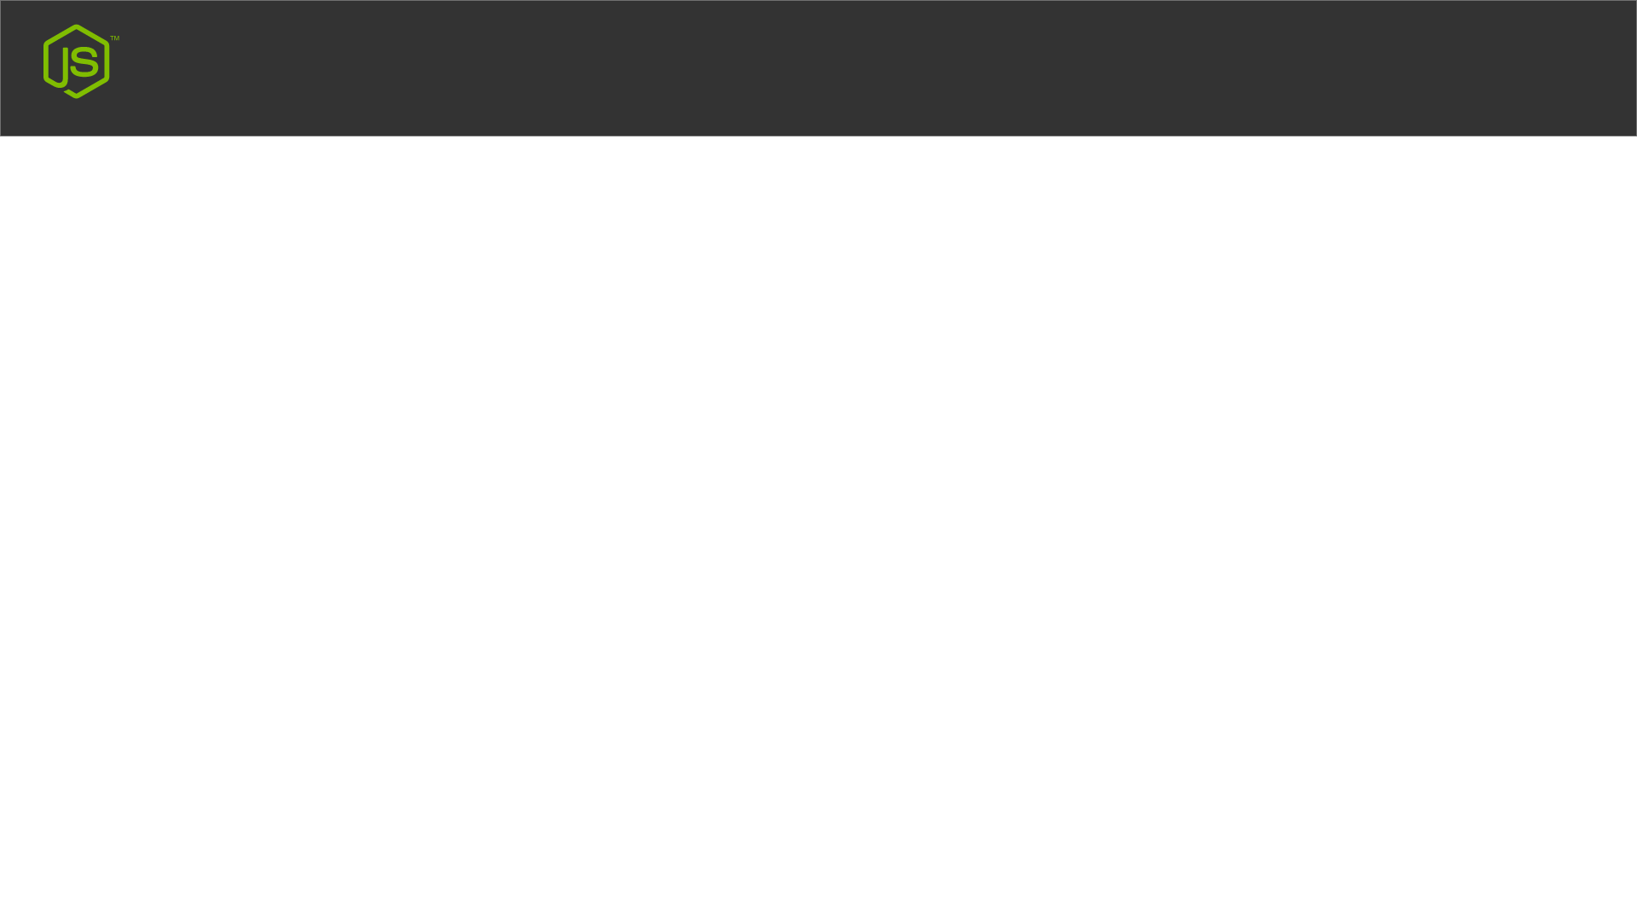
Node JS Debugging
Core Node.js debugger
Node Inspector
Built-in debugger in IDEs

